Slide 1

Design and realization of a vortex induced vibration converter
LIYANAGE A.L.D.N. (E/19/218)
Supervised by Dr. L.N.Wickramarathna
Department of Mechanical Engineering
Faculty of Engineering
University of Peradeniya
ME420- Mechanical Engineering Individual Research Project
Proposal Presentation
December, 2024

Slide 2
Introduction
Aim
Objectives
Methodology
Timeline
Reference
Content

Slide 3
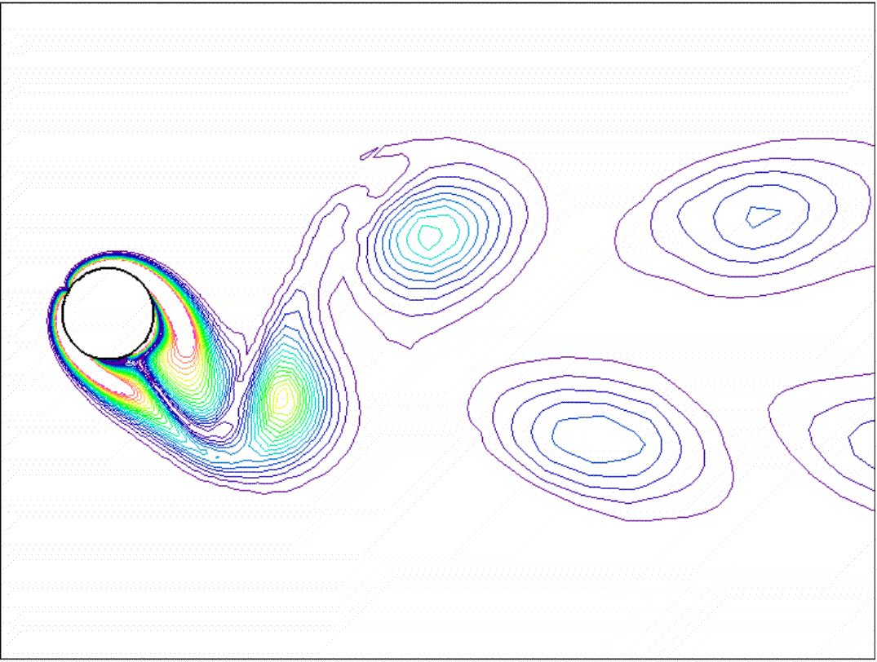
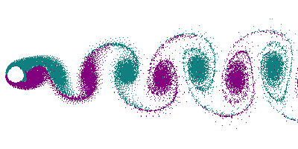
INTRODUCTION
Vortex induced vibrations
When a fluid flows past a structure, such as a cylinder or a bluff body, alternating low-pressure vortices form on either side. This phenomenon is known as vortex shedding.
These vortices generate oscillating forces in a direction transverse to the flow.
When the vortex shedding frequency approaches the natural frequency of the structure, the body begins to oscillate with a large amplitude. This motion becomes synchronized with the vortex shedding frequency and continues with significantly large amplitudes over a range of flow velocities..
Vortex induced vibration of an oscillating cylinder
Karman vortex street created by a stationary cylinder

Slide 4
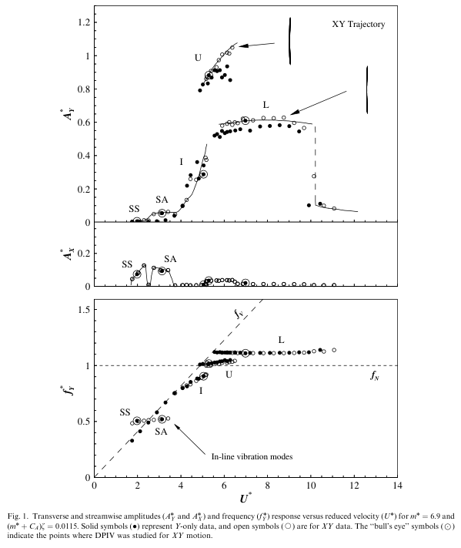
INTRODUCTION

Slide 5
INTRODUCTION
Vortex Induced Vibration (VIV) converters
They enhance the vortex shedding phenomenon to generate electrical or mechanical energy over a wide range of flow velocities.
This technology harnesses abundant energy from ocean and river currents.
The VIVACE (Vortex Induced Vibration Aquatic Clean Energy) converter, a type of VIV converter, was invented in 2008 by Prof. M. Bernitsas at the University of Michigan.
Advantages
Due to the vortex synchronization this has wide optimal operational window. Can efficiently operate in low velocity currents (0.25 – 2.5 m/s)
Scalability and adaptability
Comparably low cost

Slide 6
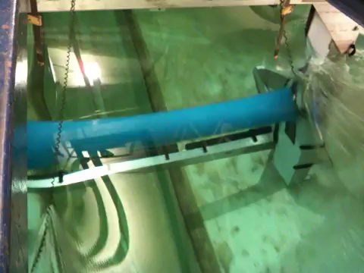
INTRODUCTION
Early VIVACE prototype testing in Michigan (2009)

Slide 7
Aim
To develop a robust mathematical model to analyze the performance of a vortex induced vibration converter
To build a lab scale prototype to validate the mathematical model.
Use the models to calculate design parameters for a range of applications scales.

Slide 8
OBJECTIVES
Obtain a conceptual understanding of the working principles of the VIVACE converter and its models.
Develop a mathematical model and simulate the system's performance.
Design and simulate a VIVACE lab prototype.
Prototype should be fabricated.
Validate the mathematical model using the prototype using lab facilities.
Design specifications should be calculated for a various application scales.

Slide 9
METHODOLOGY
Learn about the hydrodynamic behavior of fluid flow around a cylinder, non-linear vibrations, and power take-off systems.
Conduct a literature review on VIVACE converter models.
Review existing mathematical models and develop a suitable model to simulate system performance using MATLAB/Python.
Design a lab-scale prototype of the VIVACE converter using SOLIDWORKS. The scaling will be determined based on the capacity of the Fluid Mechanics Laboratory.
The design will then be simulated using ANSYS/OpenFOAM.
Fabrication and testing will be conducted using laboratory facilities.
Calculate the design particulars for different application scales.

Slide 10
TIMELINE
Weeks | 1 | 2 | 3 | 4 | 5 | 6 | 7 | 8 | 9 | 10 | 11 | 12 | 13 | 14 | 15 | 16 | 17 | 18 | 19 | 20 | 21 | 22 | 23 | 24 | 25 | 26 | 27 | 28 | 29 | 30
Finalizing the project topic
Project proposal presentation submission
Literature review about vortex induced vibration and VIVACE converter models
Literature review about non linear vibrations
Literature review about power take-off systems
Understaning of existing mathematical models
Mid Video Presentation and viva
Develop a mathematical model for VIVACE
Design and simulation of the scaled-lab prototype
Demonstration
Lab prototype fabrication (without generator)
Lab. Testing I
Implementation of the generator
Study possible improvements to the system
Lab. Testing II
Final Evaluations

Slide 11
REFERENCES
Bernitsas, M., Mortimer, E., Cooley, M., Director, M., Device, H. and Workshop, M. (2011). The VIVACE Converter Enhancing Flow Induced Motions to Harness Hydrokinetic Energy in an Environmentally Compatible Way. [online] Available at: https://www.nrel.gov/docs/fy12osti/51421-09.pdf.
Bernitsas, M.M., Raghavan, K., Y. Ben-Simon and E. Oliver Garcia (2006). VIVACE (Vortex Induced Vibration Aquatic Clean Energy): A New Concept in Generation of Clean and Renewable Energy From Fluid Flow. doi: https://doi.org/10.1115/omae2006-92645.
‌‌Rostami, A.B. and Armandei, M. (2017). Renewable energy harvesting by vortex-induced motions: Review and benchmarking of technologies. Renewable and Sustainable Energy Reviews, 70, pp.193–214. doi: https://doi.org/10.1016/j.rser.2016.11.202.

Slide 12
THANK YOU

